Slide 1
Become the best Power Platform Admin
Michael Roth
Avanade

Slide 2




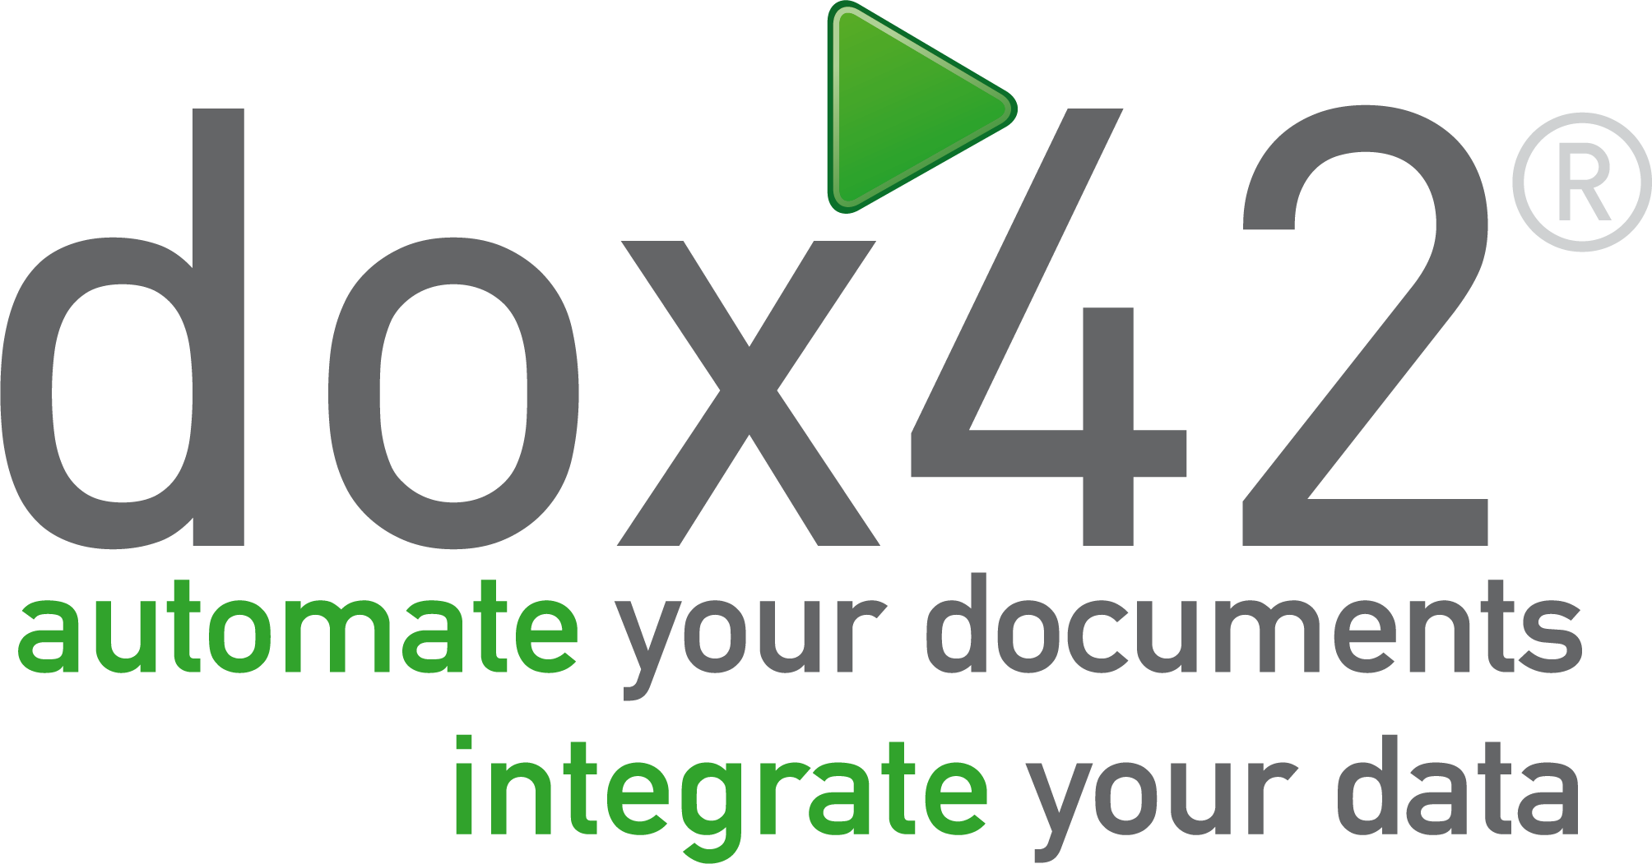




Thank You to our Sponsors…
Silver Sponsors
Online Sponsor
Lunch Sponsor

Slide 3


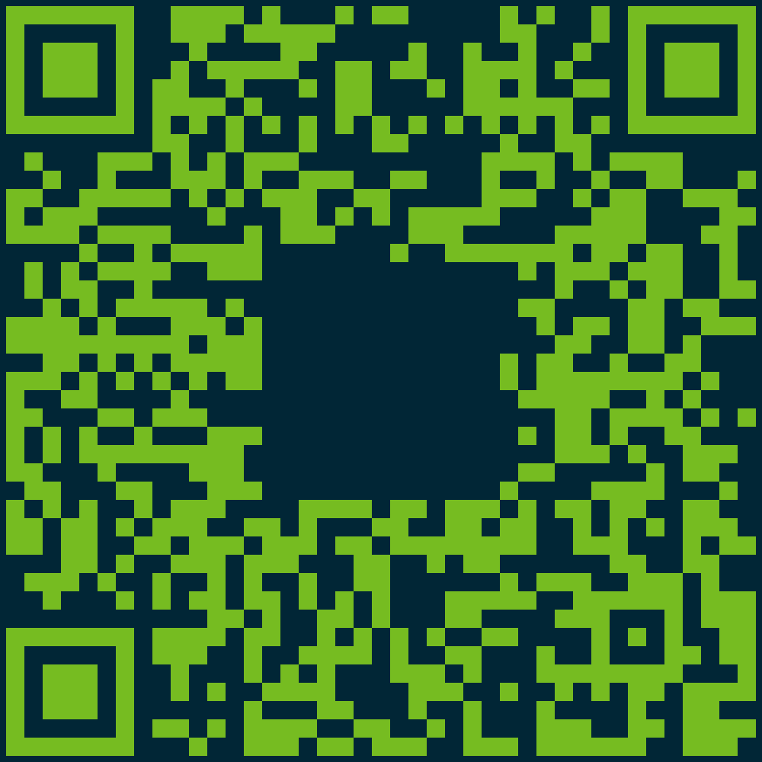



Michael Roth
Mgr Experience Tech
Avanade
Business Applications MVP
Power Platform Consultant
Solution Architect
Power Platform Governance and Administration
Graphic Designer
“❤️Kindness is my superpower”
/michaelroth42/
www.MichaelRoth42.com
@MichaelRoth42
/MichaelRoth42

Slide 4
Agenda
Welcome
What is an Administrator
What tools do you need?
Admin Center
CoE Starter Kit
How to make your life easier?
Organizational stuff
Power Automate is your friend
The exciting world of CLIs
Typical schedule and processes/tasks
Resources

Slide 5


What is an Administrator
Power Cat
Microsoft | Learn
+ Community and Experts
Protect your organization’s data (through access management)
Security roles, environments, DLPs
Monitoring
Deployment
Updates
Issue fixing
Planning, securing, deploying and supporting applications built on the platform.
plan for applications being developed and deployed
Handle day-to-day administrative tasks to manage deployments
Notes:
Let’s have a look at the official documentation. I found two good examples. The first is from Microsoft Learn:
And I really like that a lot. I often go with this definition, but there is one very important part missing in that.
That’s why I looked for another definition and I found one in the Microsoft Whitepaper for administering a low-code development platform
That’s another good definition but I have two serious issues with that. And I would like to tell you which ones, because I see those way too often when I work with customers:
Supporting application: Okay, please takes notes now: The Administrator is no first level support! I do get the fact, that when administrators take care of the platform, you get into that role easily. But please keep in mind that you are no support for how to build apps or how to fix errors in apps or flows.
The other part, I have a problem with is the planning part and that’s a bit trickier. Administrators are securing, protecting and maintaining the platform and that includes setting up environments and DLPs. But who is responsible for planning how to run the platform? Can you decide how the platform is getting utilized? Can you align the technical possibilities with the overall business strategy? Should you be responsible for that?
I think the planning part can only be done by a low-code team consisting of business decision makers, administrators and businesspeople. You as administrators are part of that, yes, but it’s not a responsibility lying on your shoulders only.

Slide 6
What is an Administrator
Secure
Monitor
Alert & Act
Deploy
Enable cross-tenant isolation
Set up DLPs
Create environments according to strategy
Manage security roles
Define data gateway strategy
Set up the CoE
Monitor new and custom connectors
Check resource usage
Set up sharing alerts
Use audit logs
Think of environment requests
Create compliance process
Welcome new makers
Create appropriate ALM lifecycle
Share apps with users
Notes:
Now if we break it down, we have 4 big things to take care of
….
Now this can be quite a hand full of work and if you were wondering why I was including that whitepaper earlier, with the definition I don’t agree with…

Slide 7
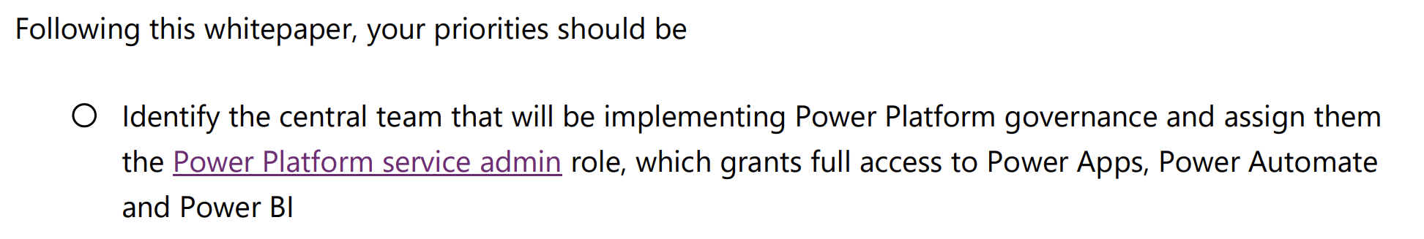
What is an Administrator / tasks of an administrator
Power Platform Administration is too much for a single person to handle!
Notes:
That is the reason, because one of the first recommended steps is this one.
Power Platform Administration is too much for a single person to handle. Tell everyone, because I usually see overworked and stressed-out admins, so please quote me here!

Slide 8


What tools do you need?
Power Platform Admin Center
Center of Excellence Starter Kit
The cool kids say “ppac” [pi:pak] now 😎 (aks.ms/ppac)
Notes:
the cool kids say nowadays.
Why? Well, because if I talk about an Admin center, you may ask, which one? There are 15 admin centers listed in M365 so it may get confusing
I assume you know the ppac already (if not, you should start learning right after this session), but I want to show you some areas that are often overlooked by some people.

Slide 9

What tools do you need?
Analytics
Tenant Isolation
Customer Lockbox
Demo time
Notes:
Now I want to show a quick demo of often overlooked features in the admin center

Slide 10
What tools do you need?
Analytics
Tenant Isolation
Customer Lockbox
Center of Excellence Starter Kit
Demo time
Notes:
Now I want to show a quick demo of often overlooked features in the admin center

Slide 11
What tools do you need?
Hard facts:
Microsoft “garage project”
20 apps
114 cloud flows
77 Dataverse tables
inspiration for processes (they work ootb)
Constant upgrades (every month)
(Support)
Center of Excellence
Starter Kit
Demo time
Notes:
The hidden treasure are those dataverse tables, I want to show you real quick.

Slide 12
How to make your life easier?
Organizational considerations
It’s a team effort!
Bring in the stakeholders (BDM, business and tech)
Get your users trained

Slide 13



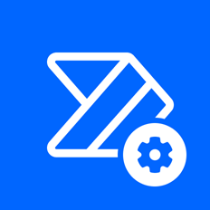

How to make your life easier?
Power Automate is your best friend
Power Platform
For Admins
Power Apps
For Admins
Power Apps
For Makers
Power Automate
For Admins
Power Automate
Management
Notes:
Main Content Slide – Dark Background: Title / Copy Text
Use this slide for inserting text-only information into the Main Content of the presentation.
The text is preformatted with font and colour styles.
Font-size can be altered to allow the content to fit the slide correctly.
The Title Text Box can be deleted if not required.

Slide 14
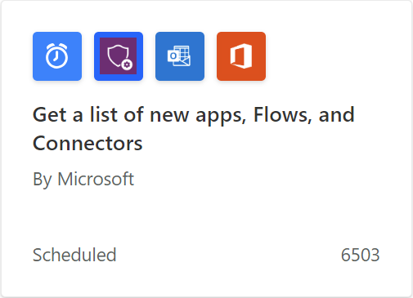
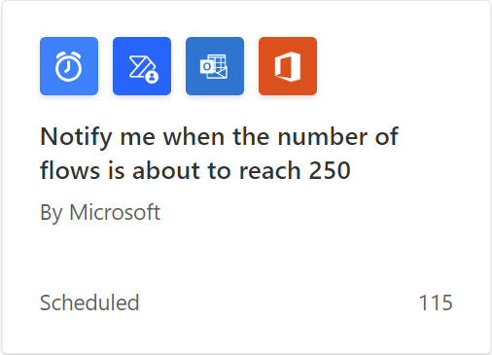
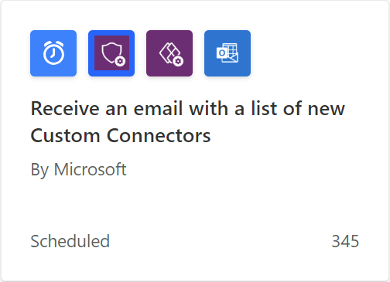
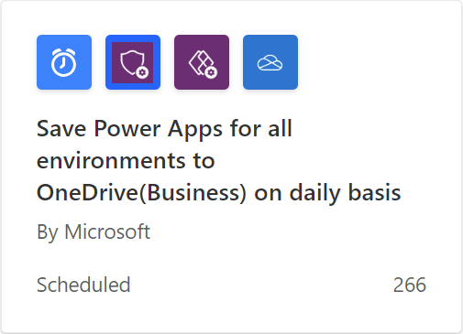
How to make your life easier?
Power Platform
For Admins
Power Apps
For Admins
Power Apps
For Makers
Power Automate
For Admins
Power Automate
Management
Notes:
Main Content Slide – Dark Background: Title / Copy Text
Use this slide for inserting text-only information into the Main Content of the presentation.
The text is preformatted with font and colour styles.
Font-size can be altered to allow the content to fit the slide correctly.
The Title Text Box can be deleted if not required.

Slide 15
How to make your life easier?
Power Platform
For Admins
Power Apps
For Admins
Power Apps
For Makers
Power Automate
For Admins
Power Automate
Management
Center of Excellence Starter Kit
Notes:
Now imagine if you combine those connectors to the data that you have in the CoE Starter Kit
You want to get a notification when apps and flows are shared with more than 20 people (business criticality, compliance check)
You want to limit sharing apps and flows with groups
You want to put apps in a quarantine, because it violates compliance guidelines
You want to make sure that apps and flows are within a solution in certain environments?
All the data is there and these connectors give you the possibility to utilize it. But there are still things that are difficult to achieve with Power Automate and even with the CoE. If you want to get really serious about being an administrator, you can take it up a notch with…

Slide 16


How to make your life easier?
The exciting world of CLIs
Example scripts by Microsoft
Apps with Custom Connectors
Apps with Premium Connectors
Apps with on Prem Connectors using Data Gateway
Apps used as SharePoint custom forms
Flows with HTTP Actions
Flows with Custom Connectors
Microsoft.PowerApps.Administration.PowerShell
Notes:
The Power Apps Administration PowerShell Module gives you so much possibilities to manage almost everything in your Platform.
There are many cool things you can do with that, just look at the amount of commands that we have
Get-Command –Module Microsoft.PowerApps.Administration.PowerShell
Cool examples:
Manage consent plans (trial and dev licenses that user can sign up for on their own)
Bulk management. Change the ownership from one user account to another or migrate apps and owners
Clear APIs to bypass consent for certain apps (user don’t have to consent for connections)
Change the standard storage of custom SharePoint forms
Set flows so that they run in the context of an app

Slide 17




How to make your life easier?
Power Automate
The exciting world of CLIs
Azure Automation
Microsoft.PowerApps.Administration.PowerShell
Runbook
PowerShell
Notes:
The Power Apps Administration PowerShell Module gives you so much possibilities to manage almost everything in your Platform.
Cool examples:
Manage consent plans
Bulk management. Change the ownership from one user account to another
Clear APIs to bypass consent for certain apps (user don’t have to consent for connections)
Change the standard storage of custom SharePoint forms
Set flows so that they run in the context of an app
There are many cool things you can do with that, just look at the amount of commands that we have

Slide 18
Typical Schedule and processes
Daily
Respond to user requests/tickets
Check notifications
Weekly
Check news and updates from community and Microsoft
Monitor custom connectors
Monthly
Review usage analytics and resource consumption to identify any trends or issues
Review and update documentation
Review and update training materials for Power Platform users
Is everything archived?
Clean up old objects (apps, flows, environments)
(Check if automation is still running)
Notes:
At the end of monthly:
But since we are talking about Power Platform and automation, think about the custom connectors, archiving and cleaning up. I hope you got the idea that you could automate those tasks as well. If you, I would add another point…
Then of course it depends what kind of processes do you have running:
Cleanup process
Compliance process
On- and offboarding
Inactivity processes
Environment requests

Slide 19
Typical Schedule and processes
…and then it depends on your processes 🤷‍♂️
Cleanup process
Compliance process
On- and offboarding
Inactivity processes
Environment requests
Notes:
At the end of monthly:
But since we are talking about Power Platform and automation, think about the custom connectors, archiving and cleaning up. I hope you got the idea that you could automate those tasks as well. If you, I would add another point…
Then of course it depends what kind of processes do you have running:

Slide 20

Ressources
Documentation
The best resource you can use, is your own knowledge 🫶
1. Technical governance document
Free template
2. A user-faced document
Power Platform Hub
Notes:
Main Content Slide – Dark Background: Title / Copy Text
Use this slide for inserting text-only information into the Main Content of the presentation.
The text is preformatted with font and colour styles.
Font-size can be altered to allow the content to fit the slide correctly.
The Title Text Box can be deleted if not required.

Slide 21
Wrap Up
Get a team, because it's a lot
You are not first level support
Strategy can, but must not be part your responsibility
Know the Admin Center by heart
Utilize the CoE Starter Kit
Automate your tasks and notifications
Learn the CLI possibilities
Documentation, documentation, documentation
The best security are trained users
Notes:
Main Content Slide – Dark Background: Title / Copy Text
Use this slide for inserting text-only information into the Main Content of the presentation.
The text is preformatted with font and colour styles.
Font-size can be altered to allow the content to fit the slide correctly.
The Title Text Box can be deleted if not required.

Slide 22




Thanks for powering through
@MichaelRoth42
/michaelroth42/
www.MichaelRoth42.com
github.com/MichaelRoth42
Notes:
Main Content Slide – Dark Background: Title / Copy Text
Use this slide for inserting text-only information into the Main Content of the presentation.
The text is preformatted with font and colour styles.
Font-size can be altered to allow the content to fit the slide correctly.
The Title Text Box can be deleted if not required.

Slide 23
Thank You to our Sponsors…
Silver Sponsors
Online Sponsor
Lunch Sponsor

